Slide 1

Breach of Code of Conduct

Slide 2

What happens if I breach the Code?
Complaints received from councillors/clerk/residents
Monitoring Officer (in consultation with Independent Persons) responsible for upholding standards and dealing with complaints
Committee of members decide outcome in public meeting
Published decisions where breach found
Sanctions can be applied

Slide 3
How can I get advice?
Monitoring Officer, through code-of-conduct inbox
Democratic Services
Head of Legal Services (Deputy Monitoring Officer)
Parish/Town Clerk on other roles (who may also seek advice from MO)
IF IN DOUBT, SEEK ADVICE FIRST

Slide 4
Your Interests

Slide 5
Why do we need to register?
Openness & Transparency
Public confidence in decisions
Protect you/Council & your/ Council’s reputation
Avoid legal challenge

Slide 6
Types of Declarable Interests
Disclosable Pecuniary Interest - DPIs
Other Registerable Interests -ORI
Non-Registerable Interests –NRI
Gifts/Hospitality

Slide 7

DPIs
Criminal Offence not to disclose DPI
Yourself and your spouse, civil partner or similar
Notify Monitoring Officer within 28 days

Slide 8
DPIs
DPIs are (for you and partner):​
  Your job​
  Anybody sponsorship in last 12 months (including who paid your election expenses​)
  Any ongoing contracts with the council​
  Any land/property you own or rent in Herefordshire
  Any property you or your business rents from the council​
  Any securities in companies operating or holding land in Herefordshire above certain valueInterests) Regulations 2012 (legislation.gov.uk)

Slide 9
Other Registerable Interests
Limited to you
Includes:
  Unpaid directorships
  Any body you are a member/general control & appointed by Council.
  Any body which is (i)charitable or (ii) public opinion-policy or (iii)functions of public nature and you are a member/general control iv) is not open to the public without formal membership

Slide 10
Non Registrable Interests
Relates to you and family/close associates
Financial or wellbeing interests – affects or directly relates
You should not participate in the relevant business in two circumstances:
a. when a matter directly relates to the financial interest or wellbeing, or
b. when a matter affects that interest to a greater extent than it affects the majority of inhabitants and a reasonable member of the public would thereby believe that your view of the public interest would be affected

Slide 11
Gifts & Hospitality
Your choice whether to accept gifts & hospitality
Register gifts of £50 or more, whether or not you accept
Would you have been offered it, if you had not been a councillor?
If in doubt, register – transparency
Do not accept if it would lead to a perception of influence

Slide 12
What you must do?
Add to the Register of Interests
Declare your interests
Decide if your interest means whether you should continue to take part

Slide 13
Registering Interests
Within 28 days of acceptance of office (DPIs, ORIs)
Keep Register up to date
Criminal Offence not to disclose DPI
Yourself and your partner
Notify MO through your Clerk

Slide 14
Declaring Interests
Declare relevant interests at:
  Decision making meetings
  Any meetings which you attend as a Councillor
If new interest/gift – add to Register within 28 days
Keep Register up to date

Slide 15
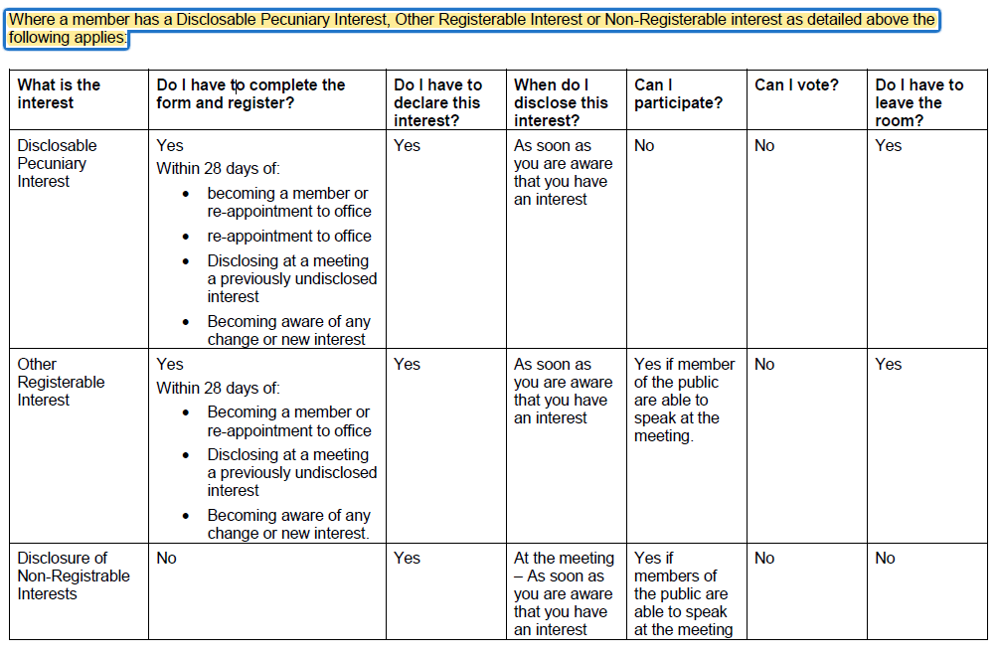
Declaring Interests at Meetings
Yes

Slide 16
Dispensations
Number with an interest so great it would impede business
In the interests of persons living in the council’s area.
Otherwise appropriate to grant a dispensation

Slide 17
Predetermination
& Bias

Slide 18
Predisposition, predetermination and bias
Predisposition - having an opinion on something but you have not yet made up your mind
Predetermination – having decided on an opinion on something where no argument will change your mind
Bias: - being influenced by prejudice or partiality when making a decision

Slide 19
How to get assistance or advice?
  Clerk
  Monitoring Officer, through the code-of-conduct inbox
  If in any doubt, ask for advice

